Slide 1
Countering carelessness: a case for academic leadership as citizenship
Magda Fourie-Malherbe
Centre for Higher and Adult Education, Stellenbosch University
S0TL Conference 2018

Slide 2
Overview
Contextual theory of leadership
The context: the toxic university?
What are the forces leading to our institutions becoming toxic?
Have we become care-less institutions?
Experiences of positional academic leaders in a care-less institution
Towards a ‘new’ university through distributed leadership, an ethics of care and academic citizenship

Slide 3
26 April 2018
Notes:
the passing of Professor Brenda Leibowitz on Thursday, 26 April 2018.

Slide 4
27 July 2018
Notes:
27 July 2018

Slide 5
Context
“Its [the university’s] fundamental fault and flaw is this. It placed the burden of history on Prof Mayosi and offered him inadequate support. He had to carry the burden of history that was not of his making, he had to interface the very forces that challenged the status quo which, he, as his scientific work suggests, was inclined to support. …The real tragedy is the failure of the university to accept its own burden of history and this is the pathos which carries the name of Prof Bongani Mayosi”
[L. Thaver & B. Thaver. 2018. Reflections on the passing of Prof Bongani Mayosi: universities and the burden of history. SAJHE 32(5):15-18]

Slide 6
Context
“What kind of conditions within an institution makes it necessary that we place our best and brightest into these crucibles of intense pressure at the interface of power because there is a need to struggle on all fronts, including within the corridors of power?”
[Cairncross, Lydia. 2018. Thoughts on the death of Professor Bongani Mayosi. Daily Maverick, online 21 July 2018]

Slide 7
26August 2018

Slide 8
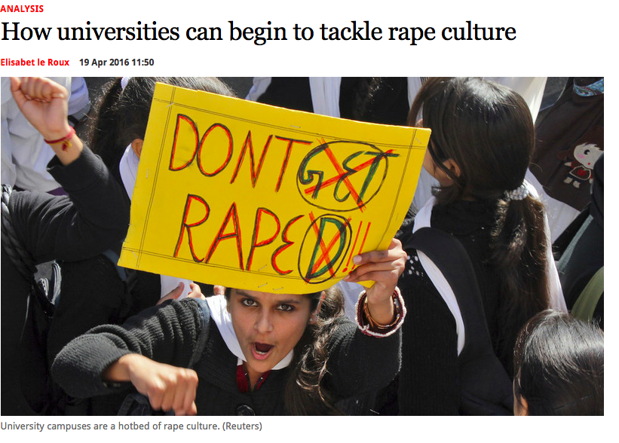

Slide 9
The toxic university?
“This is the elephant in the room, i.e. the toxic cultures that pervade our institutions and are responsible for the human, social and cultural fall-out for which we continue to pay for in social alienation” (Thaver & Thaver 2018:17).

Slide 10
International
National
Institutional
Lecturer:
Curriculum
Pedagogy
Neoliberalism
New public management
Managerialsm
Transformation
Decolonisation
Gen Z
New forms of T&L

Slide 11
The ‘care-less’ university?
The highly individualized entrepreneurialism that is at the hear of the new academy has allowed a particular ‘care-less’ form of competitive individualism to flourish.
There is a deep disrespect for the relationally engaged, caring citizen.
Within education, competitive individualism is not longer seen as an amoral necessity; rather it is seen as a desirable and necessary attribute for a constantly reinventing entrepreneur.
[Lynch, Kathleen. 2010.Carelessness: a hidden doxa of higher education. Arts & Humanities in Higher Education, 9(1):54-67]

Slide 12
Experiences of positional academic leaders in a ‘care-less’ university: SU HoD survey

Slide 13
How confident do you feel in your capacity to manage each of these tasks well?
“None of these items are overly challenging, but it is the sheer volume and tyranny of small (and big) things that interfere with capacity. Paperwork / computer 'click work' has increased exponentially as we evolve systems that should make our life easier, but don't (e.g. NAO system). Also, as our numbers (publications, postgraduates etc) increase, the crunch times (e.g. turnaround time for graduations) have become extraordinary. For example - I do not recall a Christmas break in the past 5 Y without at least 3-4 dissertations to read.”

Slide 14
Which of the following forms of support have you used in carrying out your role of Head / Chair, and how useful have you found them?
“Training does not give you resources - at the end, its all about money - some of these ‘support to Heads’ contribute to our workload and stress, as they have to prove their usefulness to justify their existence. Thus, the university typically starts to play a neoliberal, managerial game. For instance - rather give me the money for research and promotions you are spending on employee wellness !! Because what the university is actually saying is: "we do not have money to promote you (which may be long overdue), but come work with us in the park as a wellness activity and you will be OK!"

Slide 15
What is the BEST part of being a Head / Chair? What parts of the job do you find rewarding and fulfilling?
“I like the fact that I have the agency to support my staff and try to make their working experience better. On a scarier and longer term note, I like the fact that just maybe, I can influence institutional culture and make my department a kinder place. But at this stage, feeling tired and overwhelmed and suffering from decision fatigue, the small pay bump feels like the best thing...”

Slide 16
What is the WORST part of the job of being Head / Chair? What do you find most challenging or most demoralising?
”Being an academic has become a strange creature, and it's difficult to manage colleagues' deep dissatisfaction at being a cog in the crushing wheel: reduced to research outputs and supervision throughputs and teaching input subsidy, all to balance the books. This while there seems increasing money and respect allocated to those who are in The Senior Office of X and Y, where research is being conducted on research, or on re-branding the re-branding. I am by nature a healthy sceptic, but even this can go septic, when one has to filter colleagues’ (understandable) toxicity towards the institution.”

Slide 17
Is the university in ruins?
“The doom-mongers are wrong: the university is severely damaged, but it is not in ruins; net yet at any rate. The entrepreneurial university is not the end-point of the evolution of the university, being a mere stage in its history. Spaces are already opening for a new kind of university; and for it to enter a new stage in its long history. The ecological university is presaging itself, with its actual arrival much dependent on its being willed into being, and not only by the wider world but also from within the university itself”
[Barnett, Ronald. 2018. The ecological university. A feasible utopia. London: Routledge, p. 168].

Slide 18
How could we imagine our role as academic leaders in this new university?
“Leadership is necessary imaginatively to broaden a university’s sense of its possibilities; management is necessary to help the university realize those possibilities. But this would amount to a new concept of leadership. Not even just a matter of handling complexity, but of foraging for possibilities in the university’s total ecological terrain, of bringing those possibilities into view and of marshalling the university’s resource in realizing those possibilities. This, of course, points to a distributed leadership…, such capabilities being developed throughout the university”.
[Barnett, Ronald. 2018. The ecological university. A feasible utopia. London: Routledge, p. 167].

Slide 19
Academic leadership as service
“Thus, it is possible to see leadership as an activity rather than a form of status, and as a deliberative, social service grounded in self-governance, self-regulation and self-directedness. Here, communal rights and responsibilities are immanent to one another, and the health of the organization is strengthened through institutional connections to traditional communities grounded in academic values” (p.6)
[Hall, Richard, & Winn, Joss. 2017.Introduction, in Hall, Richard, & Winn, Joss (eds). 2017. Mass intellectuality and democratic leadership in higher education. London: Bloomsbury.1-15.]

Slide 20
Academic
leadership as service
Distributed leadership
Academic citizenship
An ethics of care

Slide 21
Distributing leadership
“Taking this view, leadership is about learning together and constructing meaning and knowledge collectively and collaboratively. It involves opportunities to surface and mediate perceptions, values, beliefs, information and assumptions through continuing conversations. It means generating ideas together; seeking to reflect upon and make sense of work in the light of shared beliefs and new information; and creating actions that grow out of these new understandings. It implies that leadership is socially constructed and culturally sensitive. It does not imply a leader/follower divide, neither does it point towards the leadership potential of just one person.” (my emphasis)
[Bolden, R. 2007. Distributive leadership. University of Exeter. (https://business-school. exeter.ac.uk/documents/papers/management/2007/0702.pdf]

Slide 22
Academic Leadership FIG DL research project: conditions for DL at dept/faculty level
Because distributed leadership is not consciously or not at all pursued from top management down, both faculty and individual departments are limited when it comes to influencing decision-making and policy.
The department has always been a well-functioning unit where (mostly) mutual respect reigns and every individual contributes according to their expertise. If the criteria are pursued consciously improvement is still possible. But there is a lack of resources and professional support, exacerbated by the chronic lack of time / overload.

Slide 23
Academic Leadership FIG DL research project: conditions for DL at dept/faculty level
This is a noble cause and ideal. It also correlates to the new strategic framework of SU. Enablers are also identified in the new and future SU. As indicated in the previous sections, this is not yet present or operational, or supported formally. It is happening in some instances, but the prevailing ethos remains individual excellence and performance over collective, collaborative endeavours – also in decision-making.
We have something of a culture of distributed leadership in the Faculty. However, I fear that it is under threat. The pressures of transformation and the conflicts in certain areas of the faculty have created a climate of distrust, identity politics, and caucus groups that make decisions that are then brought into meetings to be ratified. This may just be a perception. But, I am concerned that we are moving away from the sense of community and shared values that informed leadership styles in the faculty.

Slide 24
An ethics of care
The ethics of care is defined as “moral reasoning that derives from a concern for others and a desire to maintain thoughtful mutual relationships with those affected by one’s actions” (p. 65).
[Derry, Robbin. 2005. Care, ethics of. In: The Blackwell Encyclopedia of Management. Volume II Business Ethics (second edition), edited by Patricia H. Wehane and R. Edward Freeman. Pp. 65-68. Oxford: Blackwell.]

Slide 25
Care for growth/development
“Thus, the essence of caring becomes a focus on acceptance of the other, both in his or her current state, and as one capable of growth. Nurturing the development of the one cared-for becomes the critical activity in caring relationships” (p. 69).
[Liedtka, Jeanne M. 2005. Caring organizations. In: The Blackwell Encyclopedia of Management. Volume II Business Ethics (second edition), edited by Patricia H. Wehane and R. Edward Freeman. Pp. 68-70. Oxford: Blackwell.]

Slide 26
Care of others/care of self
“The concern of this approach is the responsibility of the individual to respond to another in the other’s terms, acting out of care for the other person. This is distinct from conceptions of morality as justice in that it does not attempt to follow impartial rules or ensure equitable treatment. It focuses on responsiveness to another’s needs. It also includes caring for oneself in a nurturing rather than a self-maximising way” (p.65).
[Derry, Robbin. 2005. Care, ethics of. In: The Blackwell Encyclopedia of Management. Volume II Business Ethics (second edition), edited by Patricia H. Wehane and R. Edward Freeman. Pp. 65-68. Oxford: Blackwell.]

Slide 27
A care-filled life
“The key to living well, for all people, is to live a care-filled life, a lie in which one is well cared for by others when one needs it, cares well for oneself, and has room to provide for the caring – for other people, animals, institutions, and ideals – that gives one’s life its particular meaning” (p. 170)
[Tronto, Joan C. 2013. Caring democracy. Markets, equality and justice. New York: New York University Press.]

Slide 28
Academic citizenship
“One response is to address the scope of academic leadership in terms of citizenship, as an attempt to analyse it as a bottom-up process that might become sustainable by starting from established values of collegiality and academic autonomy, rather than fetishizing missions, visons, shared goals and followership…The idea of citizenship enables leadership to be analysed as a social process in which it is considered to be relationally constructed and embedded within communities “ (p.6)

Slide 29
Why is academic citizenship important?
“The future vitality of universities will likely depend on successfully characterizing citizenship in the 21st century university, correctly diagnosing the causes of its decline, accurately determining the effects of the decline and carefully implementing steps to re-engage faculty in the life and governance of their university” (Thomson, Constantineau & Fallis 2005: 128).

Slide 30
Lecturers’ definitions of academic citizenship
‘Citizenship is about belonging to a group. A learning community is what it means most and being a member of that community’
‘Belonging to a community with a set of values, rules and objectives with an idea how it contributes to society at large’
‘Being a part of the wider academic community, contributing via scholarly activity and/or research, to the development of one’s area of knowledge and being supportive of others in the same’
Macfarlane Bruce. 2007. Defining and rewarding academic citizenship: The implications for university promotions policy. Journal of Higher Education Policy and Management, 29(3):261-273.

Slide 31
Elements of academic citizenship
Political literacy | Participating in decision-making processes at all levels within the university and respecting due process
Community involvement | With the unit, department, faculty, discipline-based community, local community, government and wider society
Social and moral responsibility | Nurturing students, supporting colleagues, developing and defending knowledge, communicating with the public
Macfarlane, Bruce. 2005. The disengaged academic: the retreat from citizenship. Higher Education Quarterly, 59(4): 296-312.

Slide 32
Implications of academic citizenship
“Staying up to date, supporting students, supporting the organization and sharing expertise in the wider sense within and outside the university’
Academic citizenship implies being part of a community which is supportive of students, colleagues and stakeholders’
‘It means doing your bit as an academic. There is limited money in the academic world and things would fall flat otherwise’
Macfarlane Bruce. 2007. Defining and rewarding academic citizenship: The implications for university promotions policy. Journal of Higher Education Policy and Management, 29(3):261-273.

Slide 33
The imperative
“Academic leaders’ are needed at all levels to restore some balance to the power structures in higher education and to facilitate the contribution of academics to effective policy and strategy. Their role would include protection of the integrity of academic work against the excesses of efficiency driven reforms. This extended role for academics could be conceptualized within a ‘fifth scholarship’ that explicitly focuses on professional academic leadership”
[Kenny, John Daniel (2009) Managing a modern university: is it time for a rethink? Higher Education Research & Development, 28:6, 629-642.]

Slide 34
Academic
leadership as service
Distributed leadership
Academic citizenship
An ethics of care
Countering care-lessness

Slide 35
In conclusion:
Never doubt that a small group of thoughtful, concerned citizens can change the world. Indeed it is the only thing that ever has. —Margaret Mead
Thank you – Dankie - Enkosi

